Slide 1
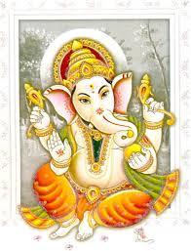
Good morning

Slide 2
Topics
Last class
ANN
BP-Learning
This class
CNN
RNN

Slide 3
Good morning

Slide 4
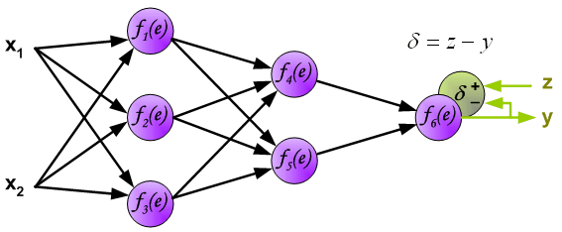
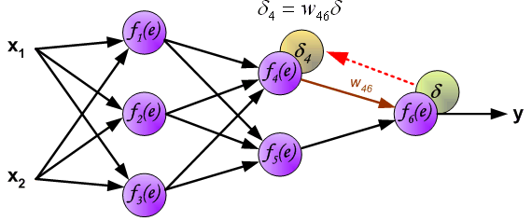
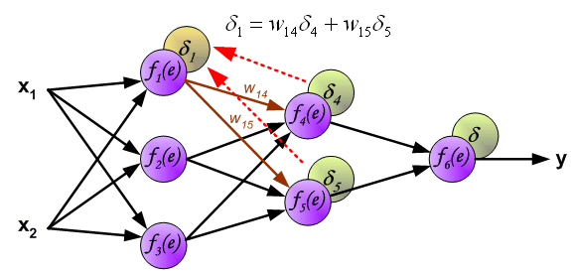
Backpropogation
Recall

Slide 5
Example: Feed forward
Bias=0
Learning rate= 1
Activation function = identity function
y=1.5
11
1
0.5
y = sum xi*wi in all steps
i
0.5
y=2.25
0.5
X1=1
4
y=1.5
0.5
0.5
y=2.25
0.5
2
0.5
6
Y=2.25, Z=3
D=0.75
y=2.25
0.5
0.5
0.5
0.5
5
X2=2
0.5
0.5
0.5
3
y=1.5

Slide 6
Example: Backpropagation of error
Bias=0
Learning rate= 1
Activation function = identity function
W´=0.5+1*0.375=0.875
D1 =0.5*0.375+0.5*0.375=0.375
1111
1
0.5
0.5
0.5
D4 =0.5*0.75=0.375
X1=1
0.5
4
D2 =0.375
0.5
Z=3
Y=2.25
D=0.75
0.5
2
0.5
6
0.5
0.5
0.5
0.5
5
X2=2
D5 =0.5*0.75=0.375
0.5
0.5
0.5
3
D3 =0.5*0.375+0.5*0.375=0.375

Slide 7
Example: Re-calculation of weights
Bias=0
Learning rate= 1
Activation function = identity function
y=1.5
W´=0.5+1*0.375=0.875
D1 =0.375
1111
0.5
1
W´=0.5+1.5*0.375=1.055
0.5
0.5
D4 =0.375
X1=1
0.5
y=2.25
W´=1.25
4
W´= ?
D2 =0.375
0.5
W´=0.875
0.5
2
y=1.5
W´=1.055
0.5
6
Z=3
Y=2.25
D=0.75
W´=1.25
0.5
0.5
0.5
0.5
W´= ?
W´=0.875
5
X2=2
D5 =0.375
0.5
0.5
y=2.25
W´=0.5+2*0.375=1.25
3
W´=0.5+1.5*0.375=1.055
0.5
D3 =0.375
y=1.5

Slide 8
Convolution

Slide 9
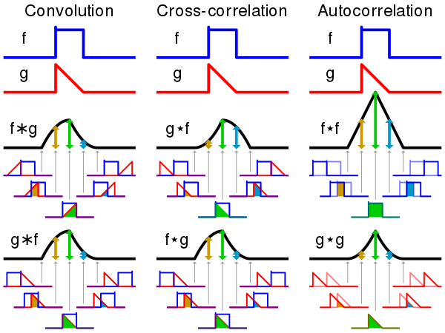
Convolution
Convolution is mathematical operation of two functions f(x) and g(x), defined as

Slide 10
ConvolutionExample
Compute the convolution of f and g =f*g
f= g=
Reflect the weight
function g
Slide g
f*g = 0 f*g = 0
Result
1
1
1/2
1/2
-2
-1
1
2
-2
-1
1
2
1
1/2
-2
-1
1
2
1
1
1
1
1/2
1/2
b
1/2
¤
1/2
¤
0
x
X-1
x
2
-2
-1
1
2
-2
-1
1
2
-2
-1
1
-2
-1
1
2

Slide 11
Convolution
Convolution is mathematical operation of two functions f(x) and g(x), defined as
In signal processing, it is combining two signals to create a third signal. Systems here are described by their Impulse response.
if we know a system's impulse response, then we can calculate what the output will be for any possible input signal. This means we know everything about the system.
If the system being considered is a filter, the impulse response is called the filter kernel, the convolution kernel, or simply, the kernel.
In image processing, the impulse response is called the point spread function.

Slide 12
Convolution neural network
A simple MLP has general issues like
Number of parameters is large
Invariance is not addressed
Topology of input data is ignored
Usually black-white patterns
CNN’s try to address these by being locally sensitive, feedforward net which can be trainde by a BPN, extracting topological properties of an image

Slide 13
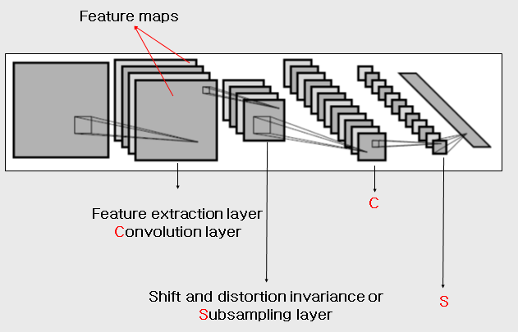
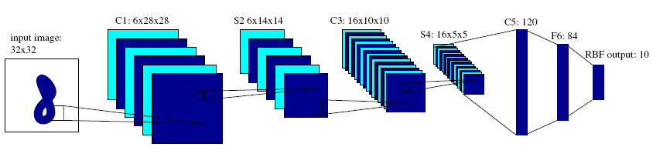
Convolution neural network
Cnn
Shared weights
C1,C3,C5 : Convolutional layer.
5 × 5 Convolution matrix.
S2 , S4 : Subsampling layer.
Subsampling by factor 2.
F6 : Fully connected layer.

Slide 14
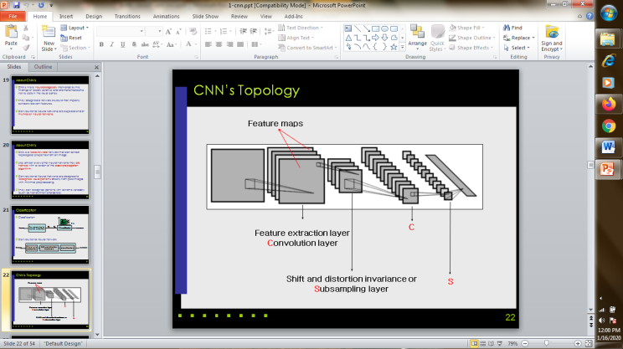
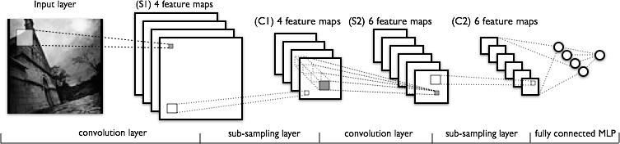
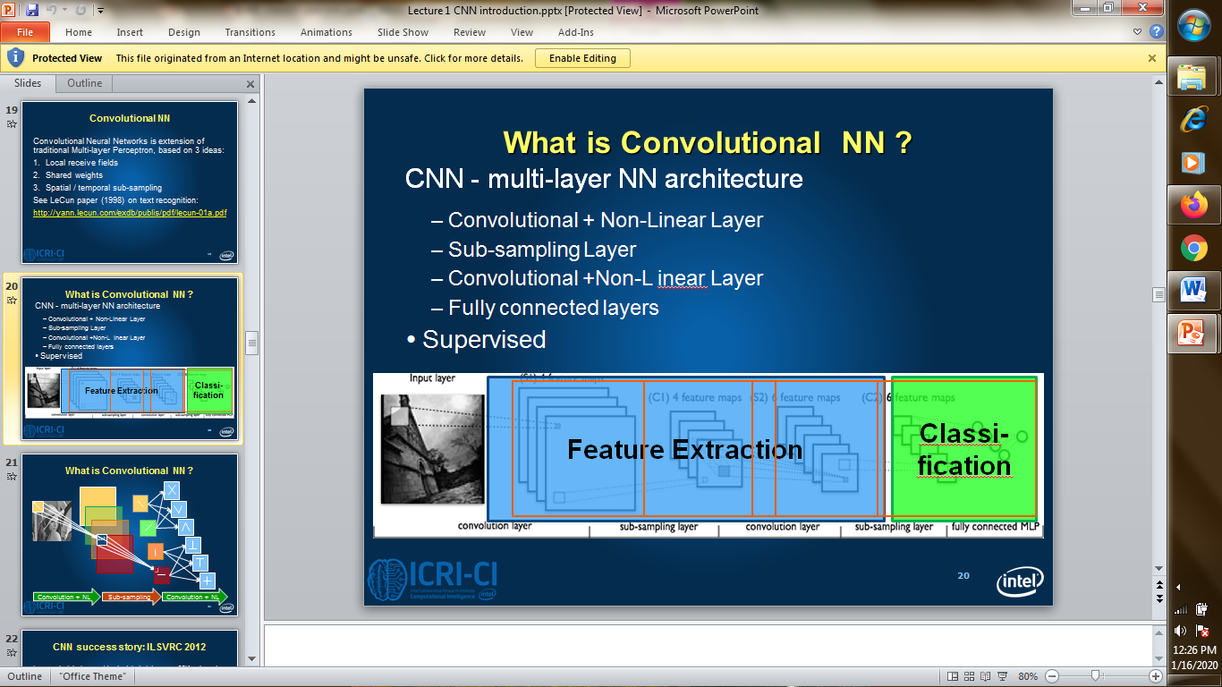
Convolution neural network
Cnn

Slide 15
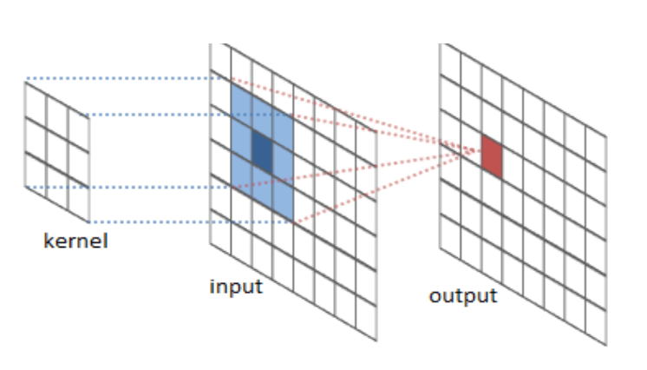
Convolution neural network
Convolution
Sparse connectivity
Parameter sharing
Filter
Slide or Stride
(Subsampling)Pooling
Padding

Slide 16
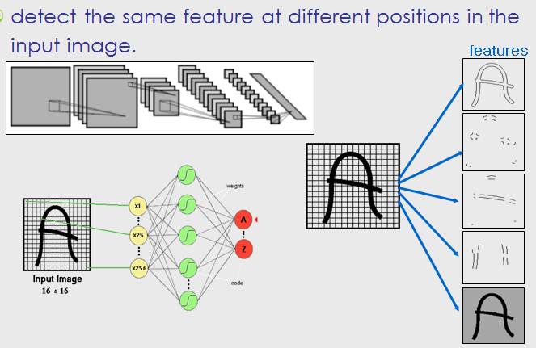
Convolution neural network
cnn

Slide 17
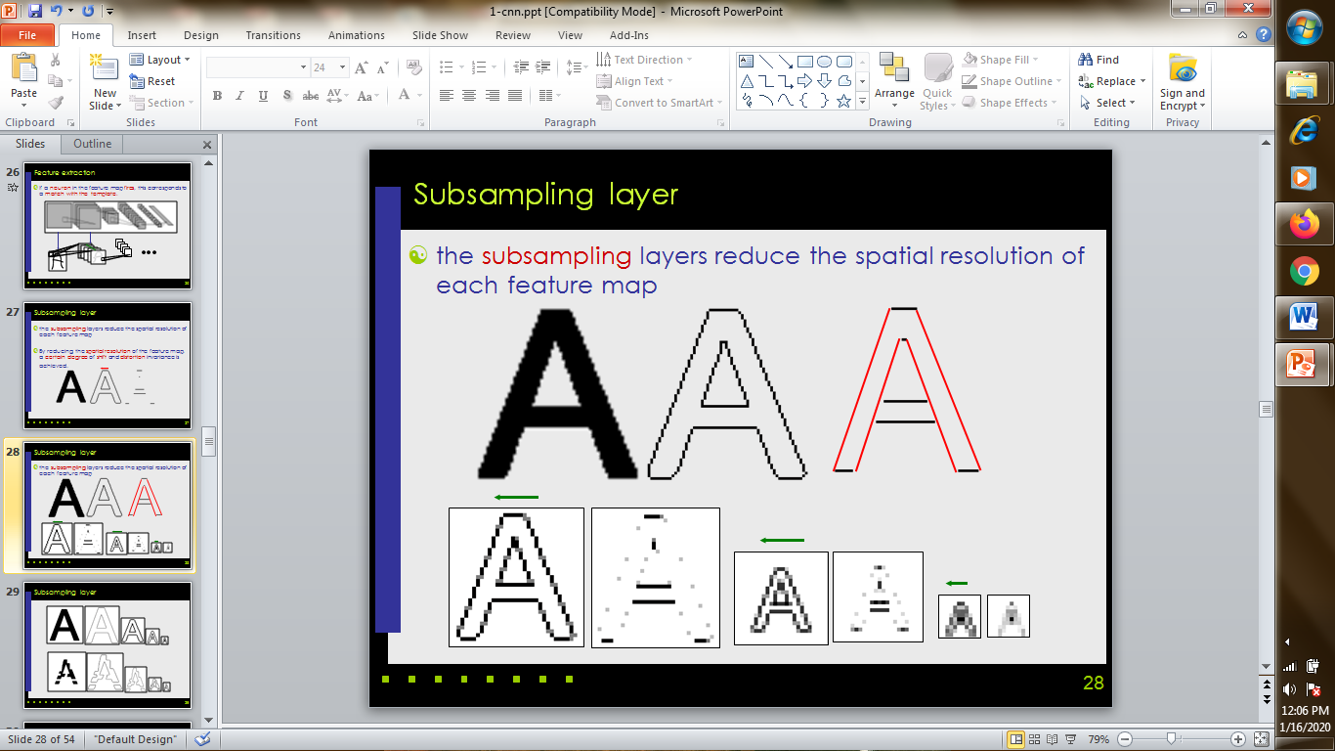
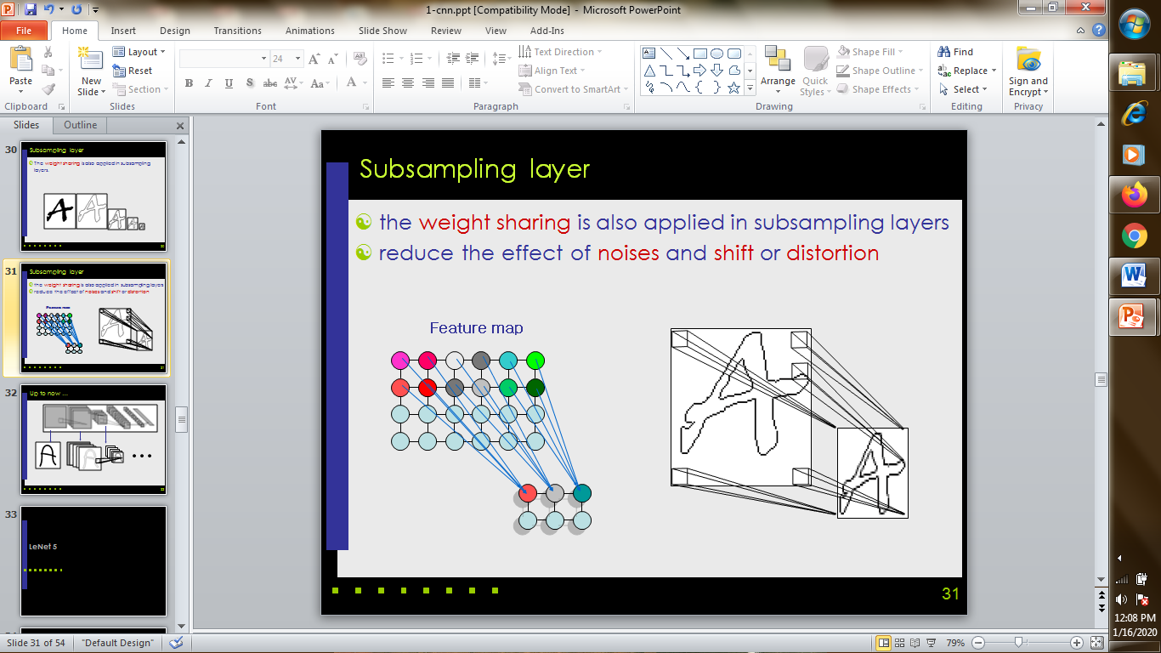
Convolution neural network
the subsampling layers reduce the spatial resolution of each feature map, reducing the noise and shift or distortion.

Slide 18
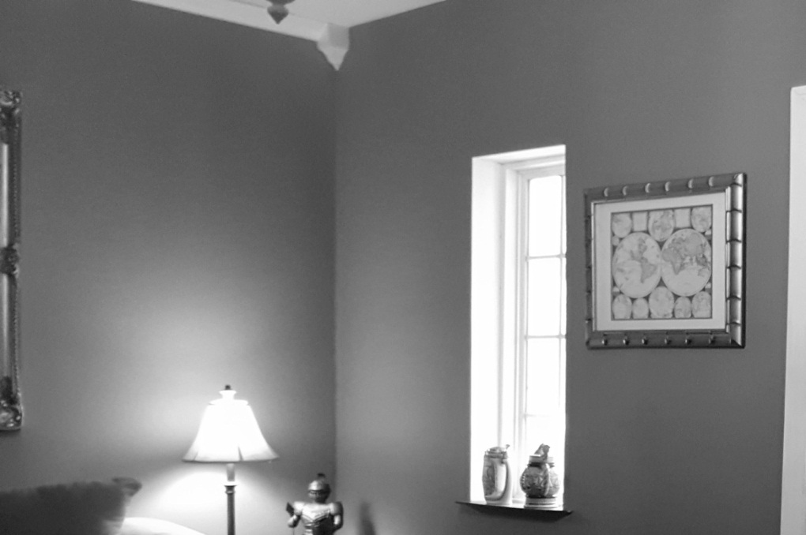
Convolution
In Image processing, Images are convoluted with filters for purposes like sharpening, blurring, edge detection..
Images are considered as a matrix whose elements are numbers between 0 and 255.
Grey scale ones are 1layer and colour ones are 3 layers(RGB).

Slide 19
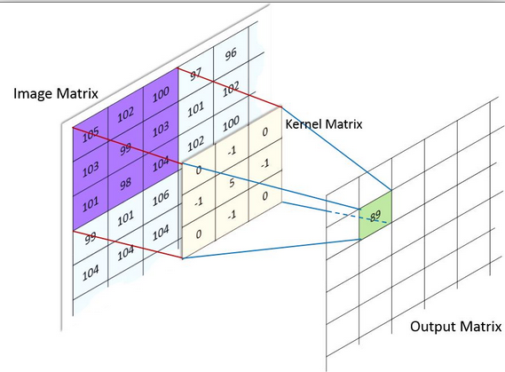
Convolution
In Image processing, Images are convoluted with filters for purposes like sharpening, blurring, edge detection..
For example, a sharpening kernel is

Slide 20
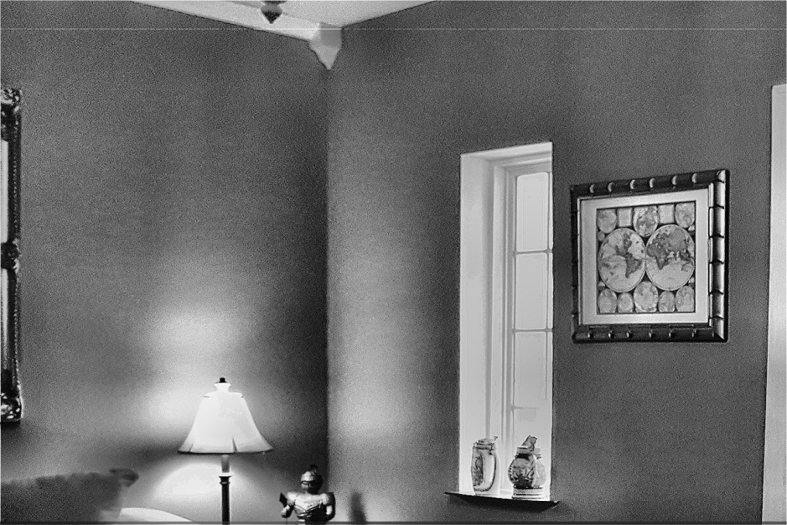
Convolution
Sharpened image is

Slide 21
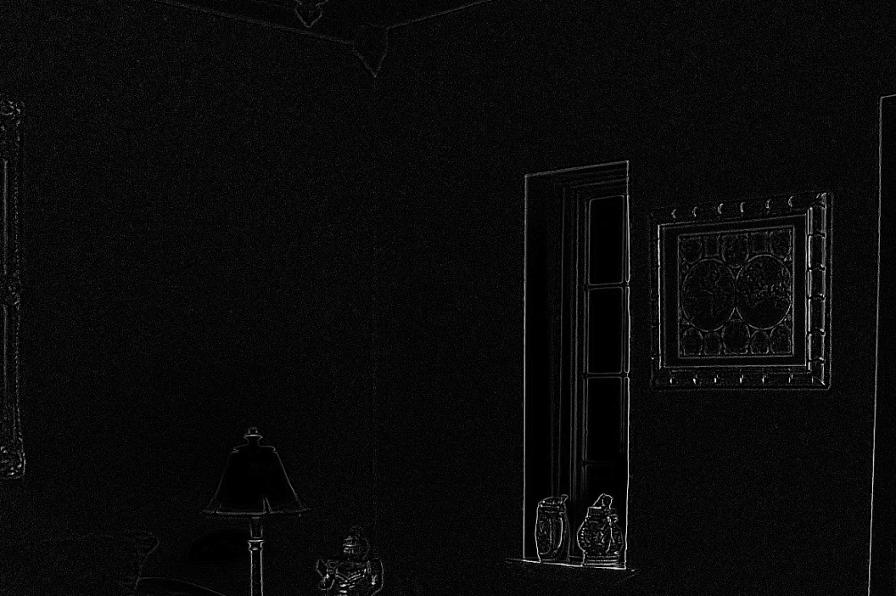
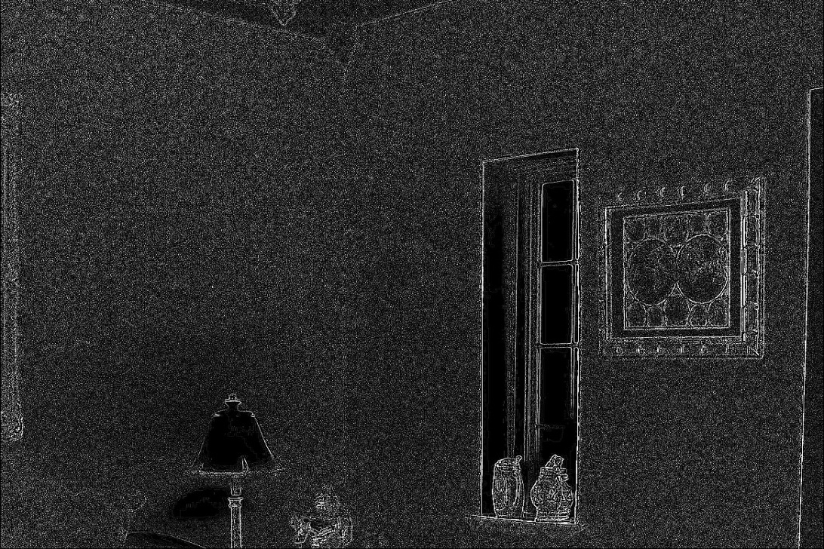
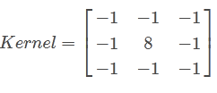
Convolution
Edge detection

Slide 22
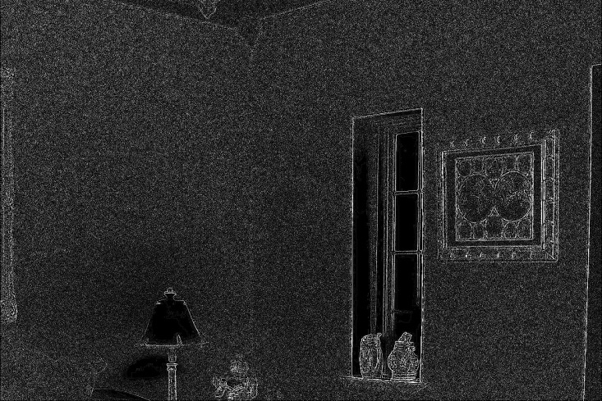
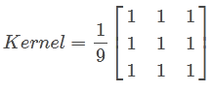
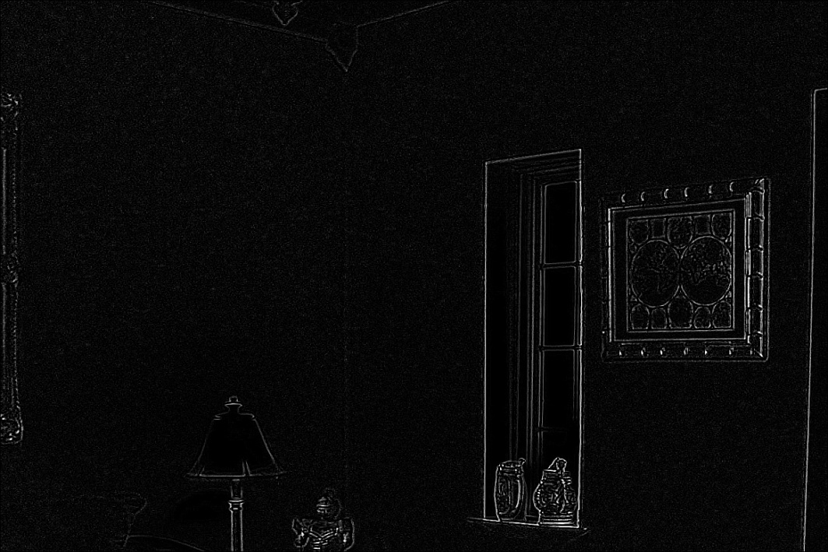
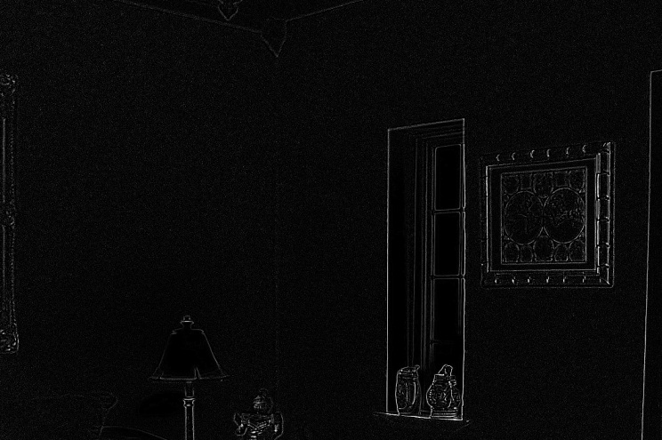
Convolution
Edge detection-Noise deduction

Slide 23
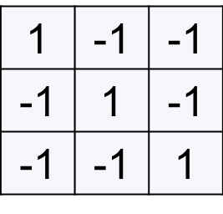
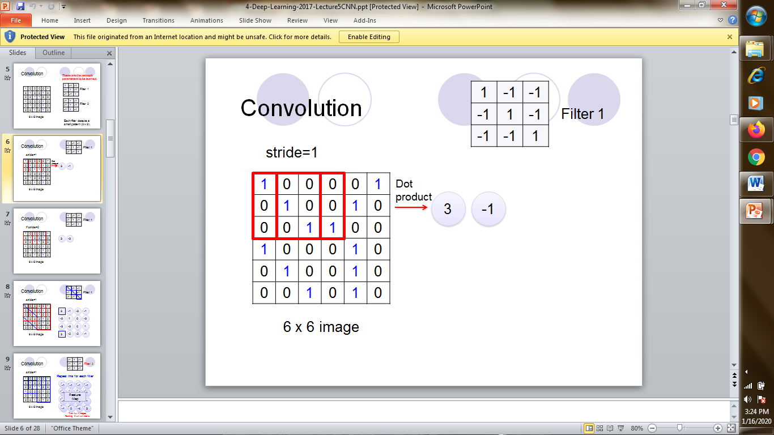
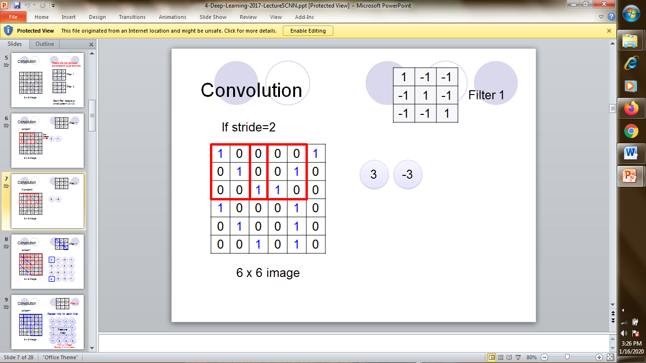
Convolution neural network
Suppose, we want to detect beaks of birds,

Slide 24
Convolution
1 | -1 | -1
-1 | 1 | -1
-1 | -1 | 1
Filter 1
stride=1
1 | 0 | 0 | 0 | 0 | 1
0 | 1 | 0 | 0 | 1 | 0
0 | 0 | 1 | 1 | 0 | 0
1 | 0 | 0 | 0 | 1 | 0
0 | 1 | 0 | 0 | 1 | 0
0 | 0 | 1 | 0 | 1 | 0
3
-1
-3
-1
-3
1
0
-3
-3
-3
0
1
3
-2
-2
-1
6 x 6 image

Slide 25
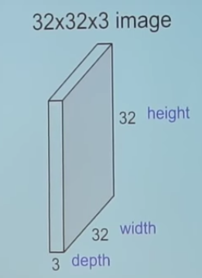
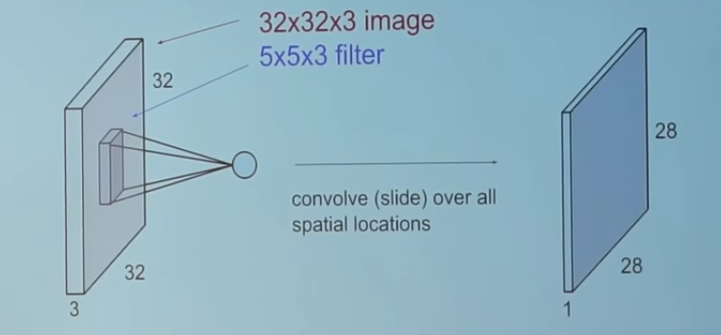
Convolution neural network
Feature Learning Phase:
The feature learning phase in a CNN consists of an arbitrary number of pairs of Convolution and Pooling layers
Input Image Filter+Convluted Image

Slide 26
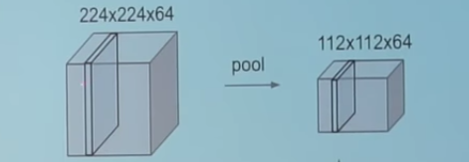
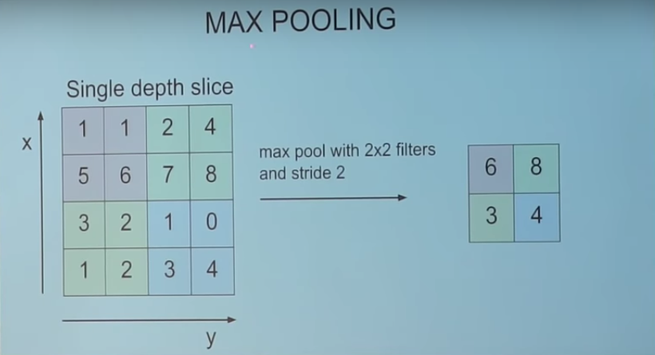
Convolution neural network Pooling
Pooling reduce the spatial size of the representation to reduce the amount of features and the computational complexity of the network.
MaxPooling

Slide 27
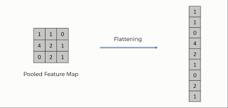
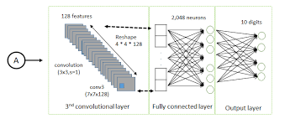
Convolution neural network
After convolution +Pooling, the output is flattened to enter a fully connected layer to get the output.

Slide 28
Convolution neural network
The fully connected layers takes as input, a flattened array representing the activation maps of high level features from earlier layers and outputs an N dimensional vector.
If a Softmax activity function is used, each number in this N dimensional vector represents the probability of a certain class.
For example, if the resulting vector for a digit classification program is [0, 0.1, 0.1, 0 .75, 0, 0, 0, 0, 0, 0.05], then this represents a 10% probability that the image is a 1, a 10% probability that the image is a 2, a 75% probability that the image is a 3, and a 5% probability that the image is a 9.

Slide 29
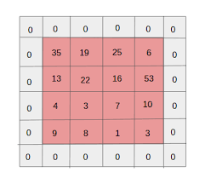
Convolution neural network Padding
Sometimes ,the sliding process can miss to apply the filter to some input array element.In such cases, Padding is employed to include all input.

Slide 30
Good morning

Slide 31
Recurrence

Slide 32
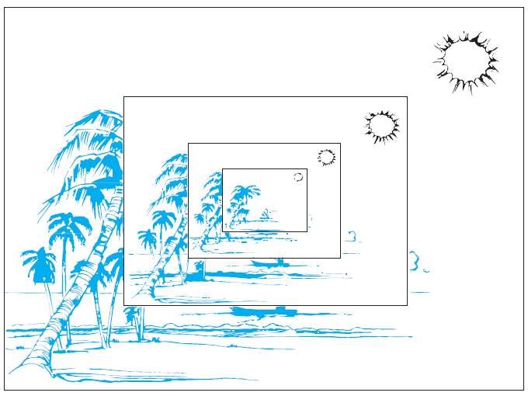
Recursion
Recursion is about defining an object with itself as a reference. For example consider the picture

Slide 33
Recursion
BASIS STEP: Specify the value of the function at zero.
RECURSIVE STEP: Give a rule for finding its value at an integer from its values at smaller integers.
Example: Suppose that f is defined recursively by
f (0) = 3,
f (n + 1) = 2f (n) + 3.
Find f (1), f (2), f (3), and f (4).
Solution: From the recursive definition it follows that
f (1) = 2f (0) + 3 = 2 · 3 + 3 = 9,
f (2) = 2f (1) + 3 = 2 · 9 + 3 = 21,
f (3) = 2f (2) + 3 = 2 · 21 + 3 = 45,
f (4) = 2f (3) + 3 = 2 · 45 + 3 = 93.

Slide 34
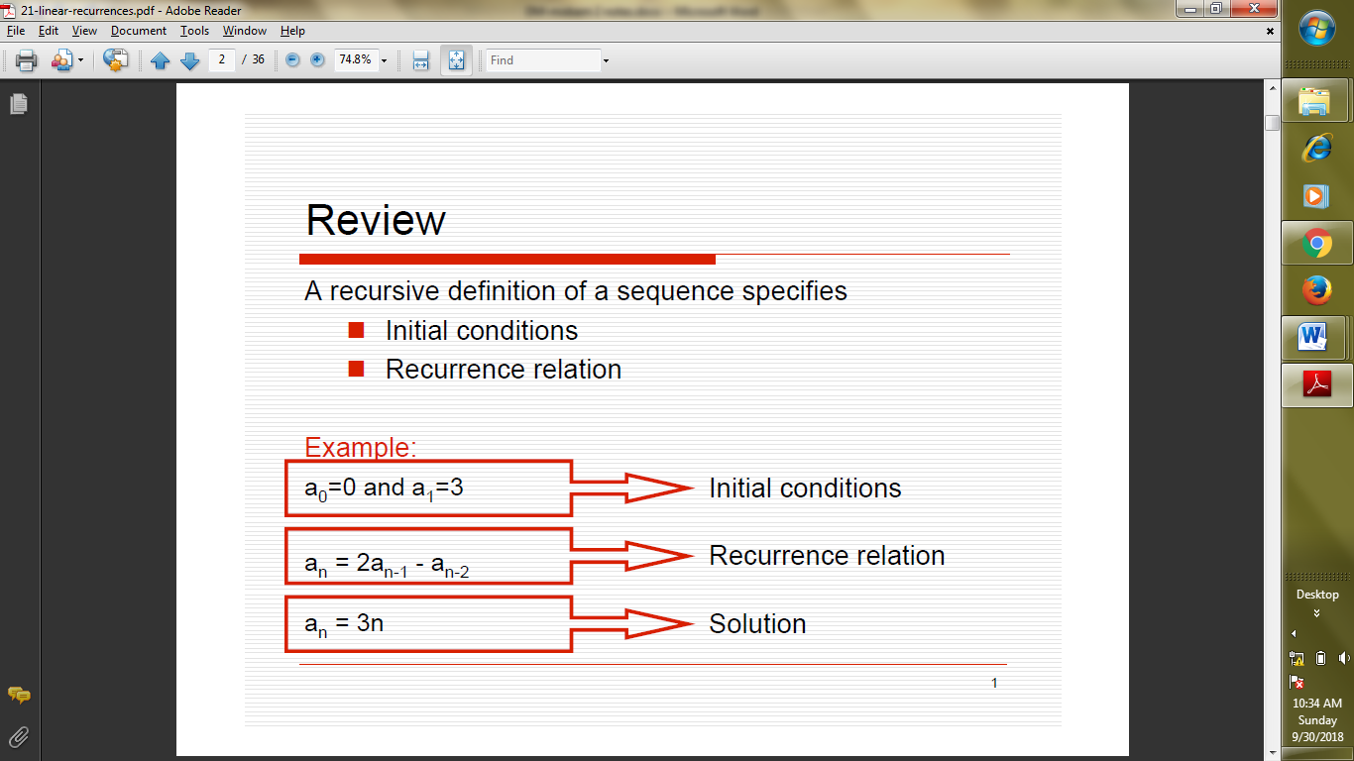
Recursion
Recursion:
Usually involves two objects
.Initial condition, Recurrence relation

Slide 35
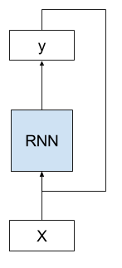
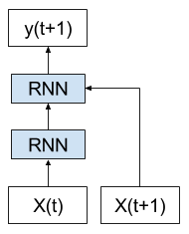
Recurrent Neural Networks
RNN’s are Temporal dynamic ANN’s.
RNN has memory(persistent state).
RNN’s have cycles or feed-forward acycles.
They are very much suited for Time series data.

Slide 36
Good morning

